Slide 1

Exploratory Data Analysis
Healthcare - Persistency of A Drug
Week 11 Deliverables
Batch code: LISUM20
16th June 2023

Slide 2

Agenda
Executive Summary
Problem Statement
Approach
EDA
EDA Summary
Recommendations

Slide 3
Project Team Group Name: Ensemble Elites
Name | Email | Country | College/Company | Specialization
Nwankwo Ezinne Anasthecia | nwankwoanasthecia@gmail.com | Nigeria | Freelance | Data Science
Bindu Musham | Bindu.musham@gmail.com | USA | The University of Texas at Dallas | Data Science

Slide 4
Problem Description
ABC Pharma is facing a significant challenge in understanding the persistency of drug usage as per physician prescriptions. The persistency of drug usage refers to the extent to which patients continue to take their prescribed medications over a specific period of time.
Currently, ABC Pharma Company relies on manual methods to track and analyze drug persistency. This involves reviewing patient records, conducting surveys, and relying on self-reporting, which can be time-consuming, prone to errors, and lack real-time insights.
To address this challenge, ABC Pharma Company has decided to approach an analytics company to automate the process of identifying drug persistency. The goal is to develop a data-driven solution that can accurately and efficiently track patients' prescribed medication usage, enabling ABC Pharma Company to gain valuable insights into medication adherence patterns.

Slide 5
Description of Numerical Features
 | Dexa_Freq_During_Rx | Count_Of_Risks
Count | 3424.000000 | 3424.000000
Mean | 3.016063 | 1.239486
Standard Deviation | 8.136545 | 1.094914
Min | 0.000000 | 0.000000
25% | 0.000000 | 0.000000
50% | 0.000000 | 1.000000
75% | 3.000000 | 2.000000
Max | 146.000000 | 7.000000

Slide 6
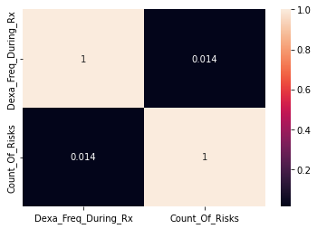
Correlation Between Numerical Features
 | The correlation between the count of risks and Dexa frequency during Rx is 0.014, which is very weak. It means the count of risks and dexa frequency during Rx have very little or nothing in common which means they can exist independently of each other. In other words, they affect drug persistency independently.

Slide 7
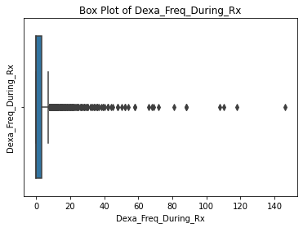
Box Plot of Dexa Frequency during Rx
 | The box plot was used to detect outliers from the dataset. After the outliers were detected in the Dexa_Freq_During_Rx column and dropping them, the new result of the dataset shape shows that 460 outliers were detected and dropped. Dropping the outliers helps to reduce bias in the results obtained.

Slide 8
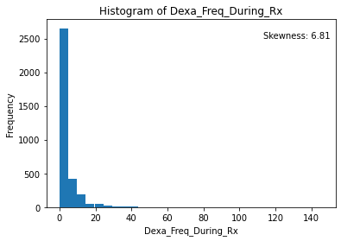
Histogram of Dexa Frequency During Rx
 | A skewness value of 6.81 suggests a significant positive skew, meaning that the distribution has a long tail on the right side. In practical terms, a positive skewness value of 6.81 indicates that the data has a concentration of values on the left side (lower values) and a few extremely high values that pull the mean towards the right. The tail of the distribution extends towards the higher values, indicating the presence of outliers or extreme values in the dataset.

Slide 9
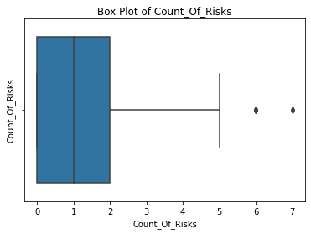
Box plot of Count of Risks
 | After dropping the outliers in the Count_Of_Risks column, it is discovered that there were 8 outliers of values 6 and 7.

Slide 10
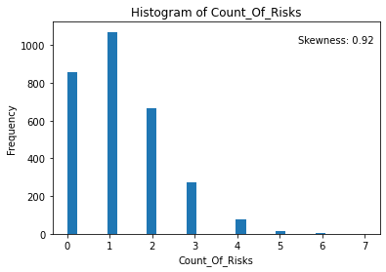
Count of Risks Frequency
 | In practical terms, a positive skewness value of 0.92 suggests that the data is not perfectly symmetrical. It indicates that the distribution has a longer tail on the right side and may have some outliers or extreme values on the higher end. However, the skewness is not significantly large, indicating a relatively mild departure from symmetry.

Slide 11
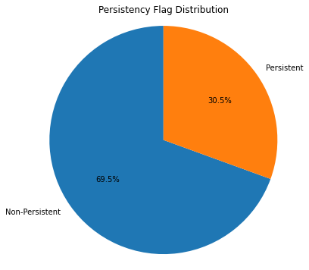
Persistency Percentage Distribution
 | From the pie chart, it can be deduced that the percentage of non-persistent patients is more than the percentage of persistent patients with values of 69.5% and 30.5% respectively.

Slide 12
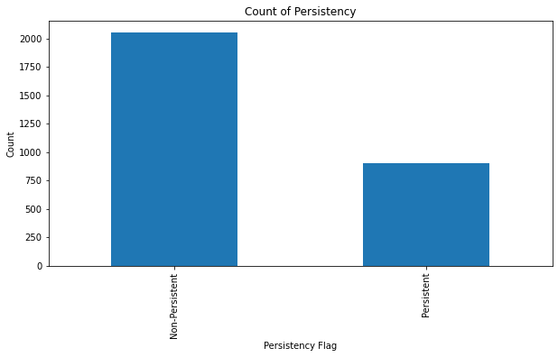
Count of Persistency
 | From the count of persistency, it can be seen that the number of non-persistent drug users are 2053 while the number of persistent drug users are 903.

Slide 13
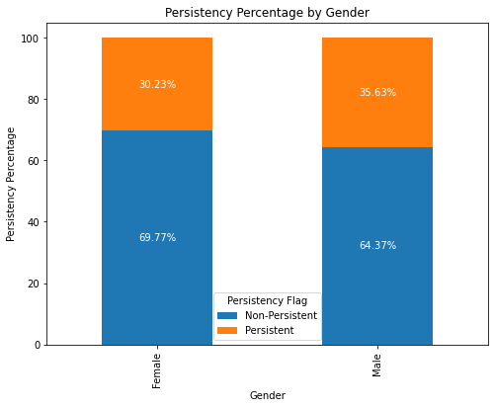
Persistency Percentage by Gender
 | The percentage of non-persistent female (69.77%) is higher than the percentage of non-persistent male (64.37%). Evidently, the males are more persistent than females.

Slide 14
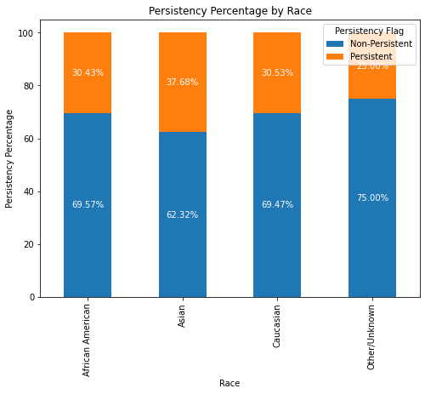
Persistency Percentage by Race
 | It can be deduced from the plot that Asians have the highest persistency percentage of 37.68% compared to other races shown and at the same time has the lowest non-persistent drug users as compared to the other races.

Slide 15
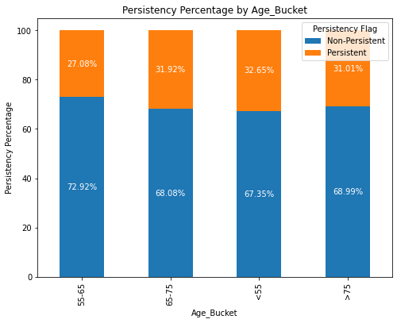
Persistency Percentage by Age Bucket
 | There is no much difference in the persistency and non-persistency of drug users in the age bucket, but the highest persistent drug users are those that fall under the age bucket of <55 while the lowest are those in the age bucket of 55-65.

Slide 16
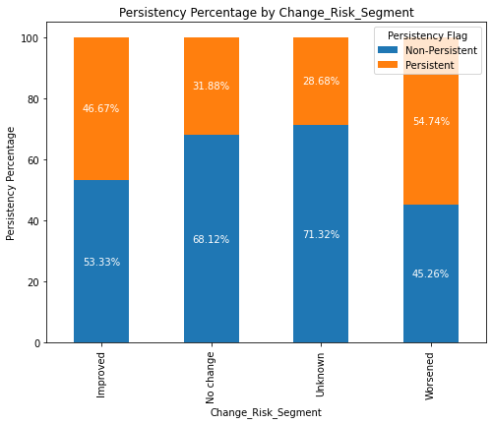
Persistency Percentage by Change Risk Segment
 | The highest percentage of persistent drug users are those with worsened change risk segment (54.74%) followed by those with improved change risk segment (46.67%)

Slide 17
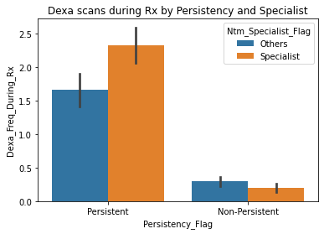
Dexa Scans during Rx by Persistency and NTM Specialist Flag
 | Dexa scans during Rx are high for persistent patients who got prescribed by NTM Specialist. There is no significant difference for NTM Specialist and others in Dexa scans for non persistent patients.

Slide 18
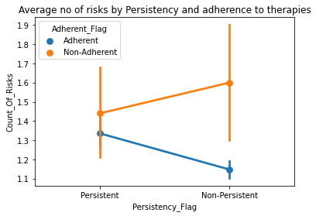
Count of Risks by Persistency and Adherence Flag
 | The count of risks for Persistent patients are high for Non-Adherent and low for Adherent patients. Similarly, for Non persistent patients, the count of risks are high when patients are non adherent.

Slide 19
Recommendations
Increase the persistency rate for female patients by providing some special discounts or coupons as they are high in filling prescription drugs.
Higher advertising and marketing in Midwest may increase the persistent rate.
The patients who got prescribed by NTM Specialist have more dexa scans during Rx. So, if we target NTM Specialist prescription drugs, the persistency rate will increase.
The number of risks are high for patients who are not adherent to therapies. We can give extra therapy sessions to attract non adherent patients to reduce risks and increase persistency.
In order to increase sales and profitability for ABC Pharma company, it is important to improve the persistency rate over time. By increasing the persistency rate, the company can achieve higher sales of prescription drugs and ultimately generate more profits.
Increased attention should be paid to patients from the age bucket of 65 and above because they are less persistent in drug usage.

Slide 20
Recommended Models
For the dataset of drug persistency, several machine learning classification models can be considered following the analyzed features.
Here are some of the recommended models that can be used.
Logistic Regression: Logistic regression is a popular choice for binary classification problems like drug persistency. It can effectively model the relationship between independent variables (features) and the target variable (persistent flag). It can provide interpretable results and handle both numerical and categorical features.

Slide 21
Recommended Models
Random Forest: Random Forest is an ensemble learning model that combines multiple decision trees to make predictions. It is versatile, robust, and performs well on a variety of datasets. Random forest can handle both numerical and categorical features, handle outliers and capture complex relationships between features. It comes highly recommended for the drug persistency dataset because of its versatility in features.

Slide 22
Recommended Models
Gradient Boosting: Gradient Boosting algorithms, such as XGBoost or LightGBM, are powerful models for classification tasks. They iteratively build an ensemble of weak learners to improve prediction accuracy. Gradient Boosting models often perform well in scenarios where there are complex interactions between features and can handle both numerical and categorical dataset.

Slide 23
Recommended models
Support Vector Machines (SVM): SVM is a machine learning algorithm that is effective for both linear and non-linear classification problems . Hence would be a good model for the drug persistency dataset. SVM aims to find an optimal hyperplane that separates different classes in the data. SVM works well when there is a clear separation between classes and can handle both numerical and categorical features.

Slide 24
Thank You

